Slide 1
School of Computer Science & Engineering
AI Application Development – IA1
PulseIQ – AI-Driven Autonomous Business Intelligence and Predictive Analytics System

Slide 2
Team members & roles
Team member name | Role
Prakruthi C | Team Lead
Bhumika B k | Customer Contact Lead
Nithya Y | Development Lead
Yashaswi B M | Marketing Lead
Notes:
Talk about how they are managing their documents, how google docs does automatic versioning
As them what they know about Android and IoS versions

Slide 3
Problem Statement
Small businesses struggle to convert raw sales data into actionable insights. Manual analysis is time-consuming, error-prone, and leads to poor business decisions.
Notes:
Talk about how they are managing their documents, how google docs does automatic versioning
As them what they know about Android and IoS versions

Slide 4
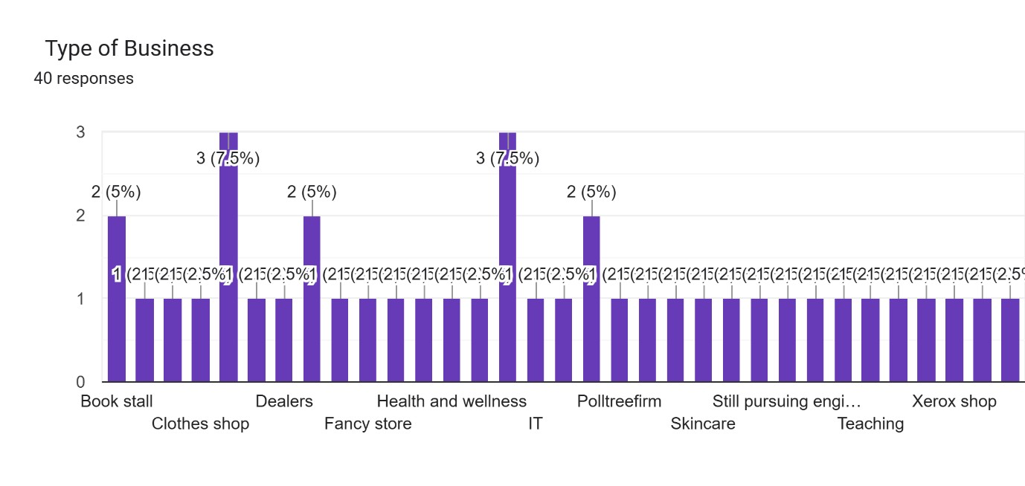
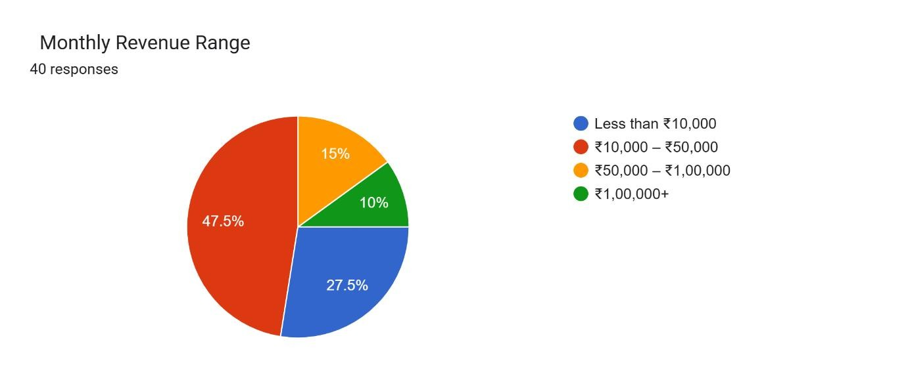
User/ Customer Understanding
Survey on google form
Notes:
Talk about how they are managing their documents, how google docs does automatic versioning
As them what they know about Android and IoS versions

Slide 5
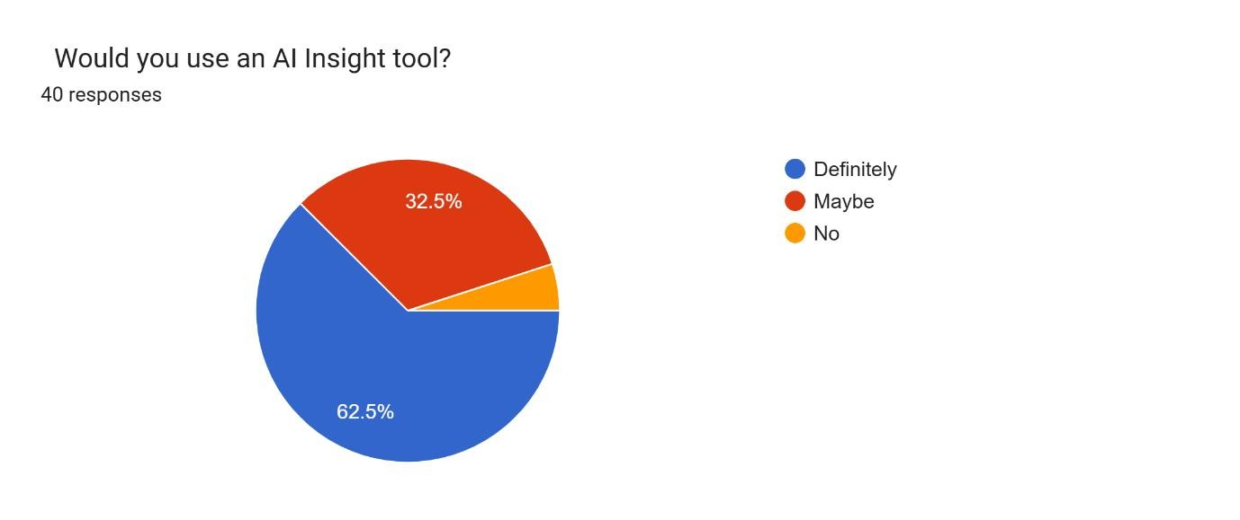

Slide 6
Ideal Customer Profile (ICP)
1. Demographic (Firmographic):
Small businesses and startups in online
E-commerce, D2C brands
No dedicated data analytics team
2. Psychographic:
Time-constrained business owners
Struggle with data analysis
Prefer simple, automated solutions
Open to AI-based tools
Notes:
Only stress on the 1st sentence – the definition
Come back to the 2nd sentence in the end as part of revision

Slide 7
Product USP
Converts raw data into plain-English insights instantly
Requires zero coding knowledge
Affordable solution using free AI tools
Provides actionable recommendations, not just dashboard
Notes:
Only stress on the 1st sentence – the definition
Come back to the 2nd sentence in the end as part of revision

Slide 8
Use Cases & High level Requirements
Input:
Sales data file
Output:
Business insights with native language voice
Charts and Dashboard
Recommendations
PDF report
Use Cases:
Upload sales data (CSV/Excel)
Analyze business performance
Generate AI insights
Detect anomalies
Download reports
Notes:
Only stress on the 1st sentence – the definition
Come back to the 2nd sentence in the end as part of revision

Slide 9
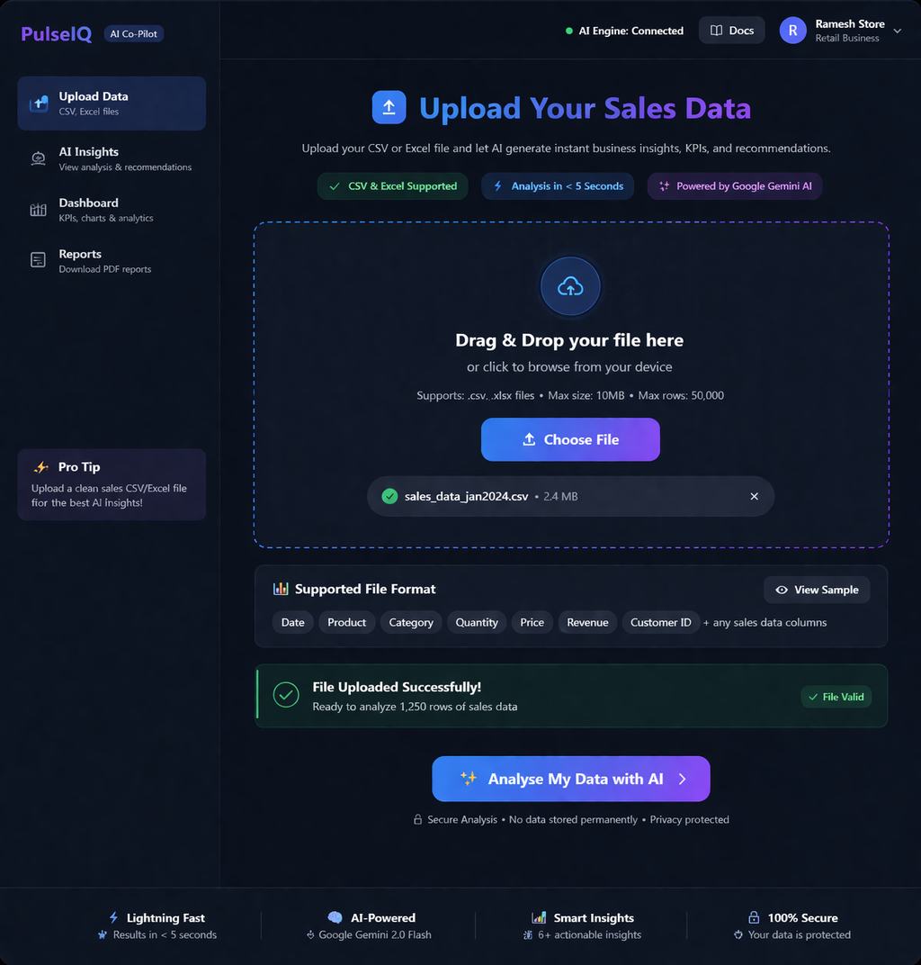
Proof of Concept (PoC) / Prototype Demo

Slide 10
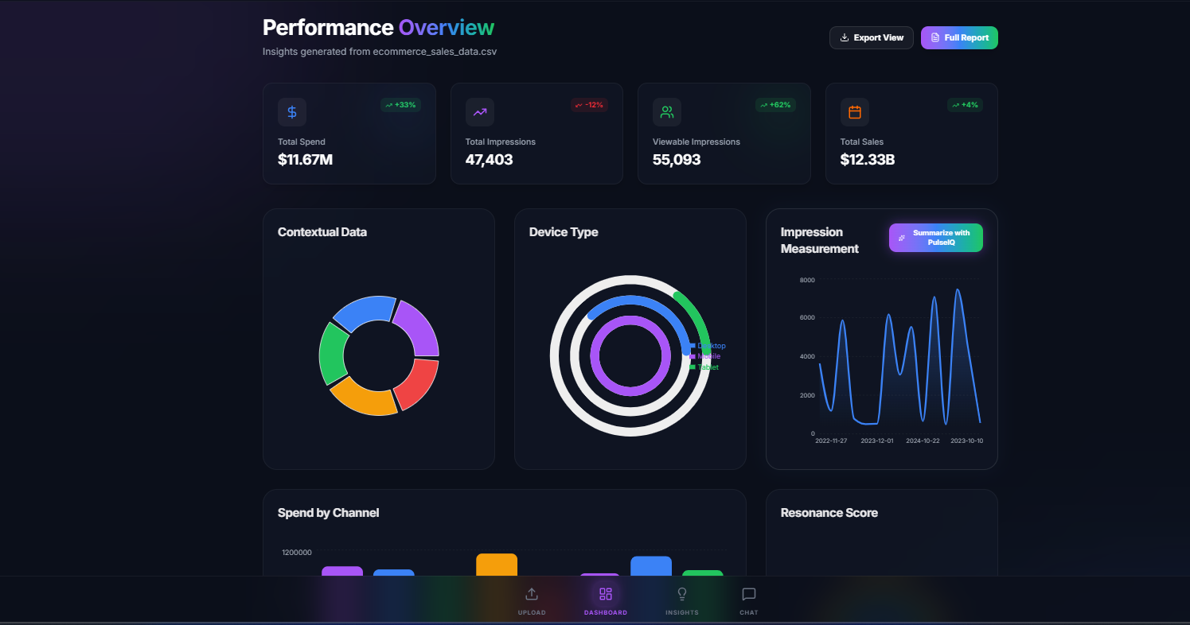

Slide 11
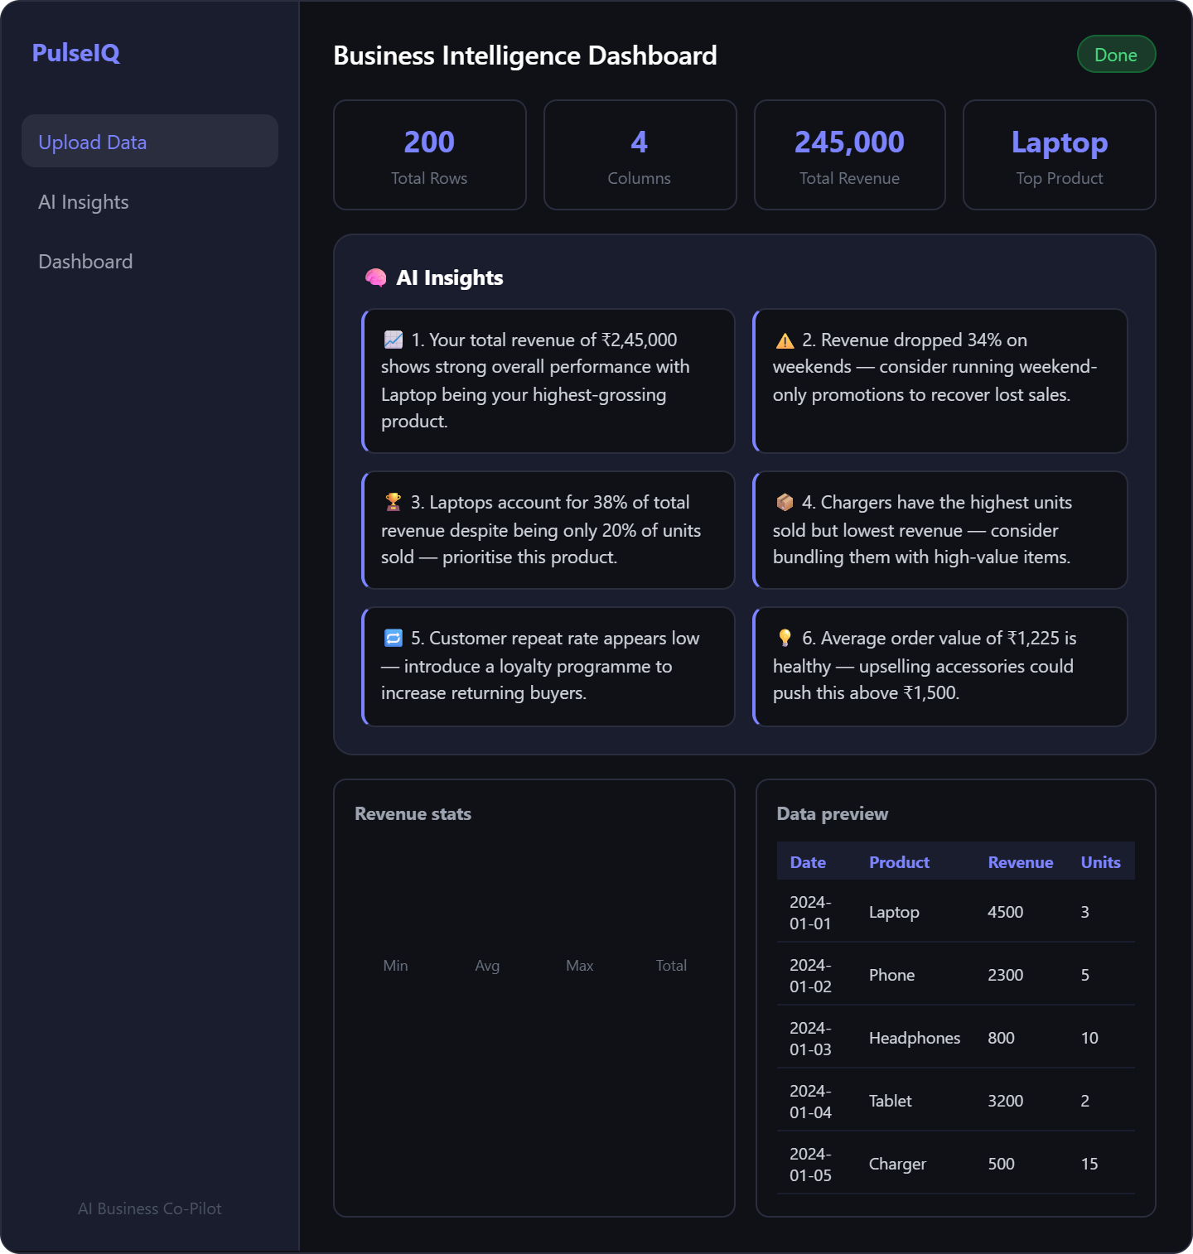
Notes:
Only stress on the 1st sentence – the definition
Come back to the 2nd sentence in the end as part of revision

